Slide 1

Pothole Detection using Roboflow Convolutional Neural Networks

Slide 2
Presentation Outline
Abstract
Introduction
Objectives
Related Work
Architecture Diagram
Datasets Used
Algorithms Applied
Results Obtained
Screenshots
References

Slide 3
Abstract
India's vast network of roads poses a maintenance challenge, and the number of accidents is increasing due to the damaged roads and potholes.
Manual inspection is time-consuming, costly, and prone to human error, making it infeasible to inspect all locations.
In order to solve this problem, various image processing techniques such as CNN and YOLO V5 can be used to identify road damage accurately and efficiently, allowing for timely repairs and reducing accidents, particularly during the rainy season.

Slide 4
Introduction
The proposed project solves the problem of pothole detection using various deep learning techniques.
It compares various deep learning models to find the best technique for predicting the damaged roads.
Algorithm with maximum accuracy is used for further implementation.

Slide 5
Objectives
To apply and compare different machine learning and deep learning algorithms on the given dataset.
To predict the damaged roads using CNN and Yolo v5 algorithms.
To predict which part of the road needs repairing for proper maintenance.
To visualize the various techniques and using the relatively best algorithm with maximum accuracy.

Slide 6
Related Work
AUTHOR | YEAR OF PUBLICATION | DESCRIPTIONS | PROS | CONS
Anup Kumar Pandey | 2022 | Predicting the damaged roads using accelerometer and CNN model. | Used ID-CNN model | Other methods not used for maximum accuracy
Deepak Kumar Dewangan | 2020 | Pothole detection for Autonomous Vehicle System using CNN | Used CNN model | Latest Models not used
Yuan Yuan | 2020 | Using Image recognition technologies | Used deep learning techniques | Limited methods used

Slide 7
Related Work
AUTHOR | YEAR OF PUBLICATION | DESCRIPTIONS | PROS | CONS
Nachuan Ma | 2022 | Using Computer Vision for Road imaging and Pothole Detection | Used many sensors and devices | Not used Yolo V5
Ratnajit Mukherjee | 2021 | AI based road inspection system | Used RGPNet model | Used only one method
Dharneeshkar J | 2020 | Detection of Potholes using Yolo | Used various Yolo models | Latest Yolo model not used

Slide 8
Related Work
AUTHOR | YEAR OF PUBLICATION | DESCRIPTIONS | PROS | CONS
Byeong-ho Kang | 2017 | Used 2D LiDAR and Camera for pothole detection | Used LiDAR sensors and camera for real time detection | Basic image based algorithms used
Kavitha R | 2021 | Pothole detection using Yolo | Used Yolo model | Other models not used
K. Vigneshwar | 2016 | Counting of potholes using image processing techiques | Used Gaussian Filtering model | Latest models not used

Slide 9
Inferences from Related Work
Based on the studies from the literature survey, it is noted that the pothole detection problem is solved using various algorithms.
Different approaches are followed but with less accuracy and only some algorithms are used in a particular approach.
Latest deep learning models are not used.

Slide 10
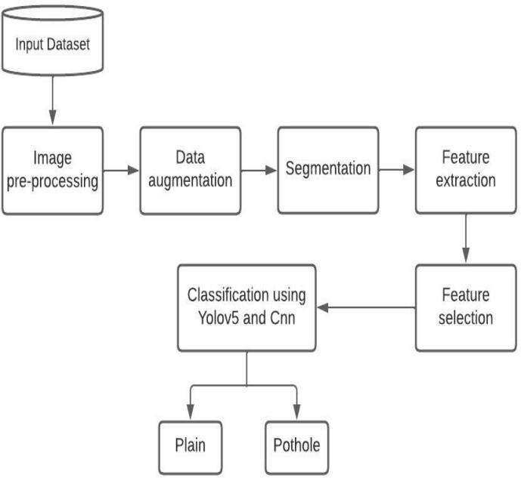
System Architecture

Slide 11
Datasets Used
For YOLO v5 algorithm, the dataset is imported from the Roboflow website. It is a website which provides datasets in different format options.
For the CNN algorithm used, the dataset is downloaded from the Kaggle website. In this dataset, there are plain images as well as images with potholes.

Slide 12
Algorithms Applied
To predict the potholes, various algorithms are used and the algorithm with the highest accuracy is found out.
The various algorithms used are CNN and YOLO v5 and by implementing both these algorithms, the model with the highest accuracy is found out.

Slide 13
Results Obtained - CNN
In CNN, the dataset used was containing a total of 960 images, 486 – plain images and 474 – pothole images.
Here, 768 images were passed for training and the remaining 192 images were used for testing.
The accuracy obtained using CNN model was 71.34%

Slide 14
Results Obtained – YOLO v5
In CNN, the dataset used was imported from the Roboflow website.
Here, a total of 465 images were used for training and the training was done on different epochs and batch sizes.
The epoch value with the best accuracy was taken into consideration.
The accuracy obtained using this model was 73.34%

Slide 15
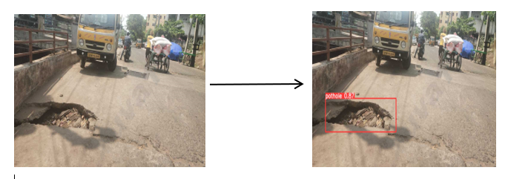
Screenshots
In the below image, the pothole is found out using the Yolo v5 algorithm.

Slide 16
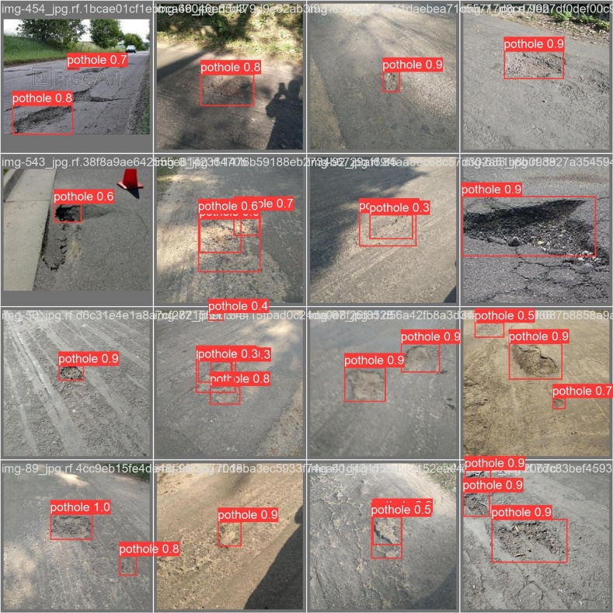
Screenshots
In the below image, the pothole is found out using the various algorithms.

Slide 17
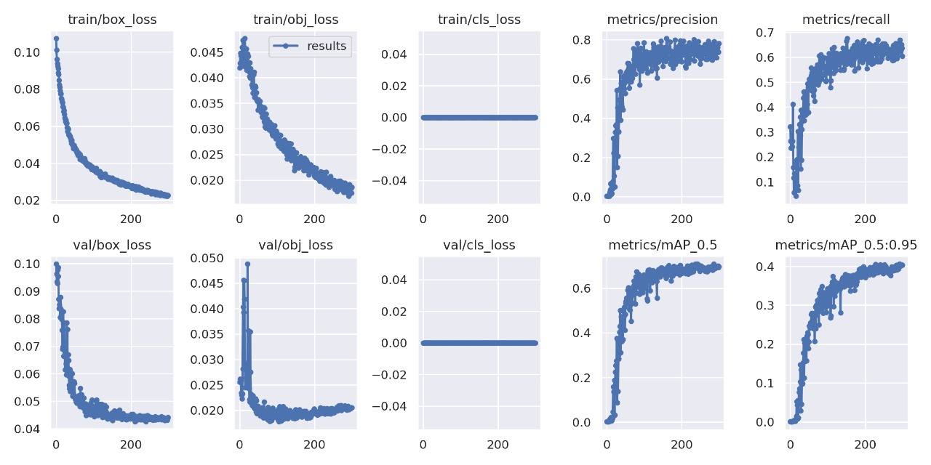
Screenshots

Slide 18


